Slide 1

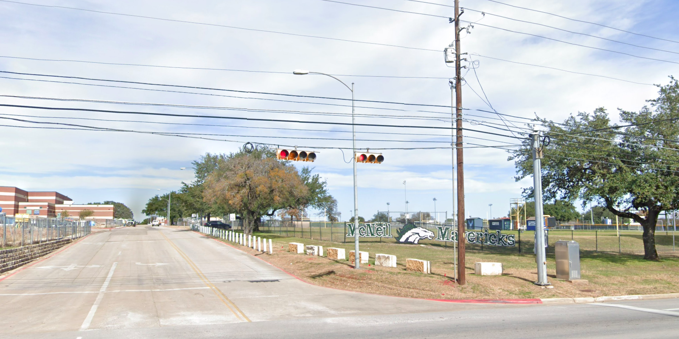
Austin Transportation Department Signs Work Orders
Created By: Susanne Gov Created Date: 2020-08-10 Location Name: 5501 BLK MC NEIL DR (MCNEIL HIGH SCHOOL) Intersection ID: 0 Cardinal Direction: N
Sign Type | Install/Remove

Slide 2
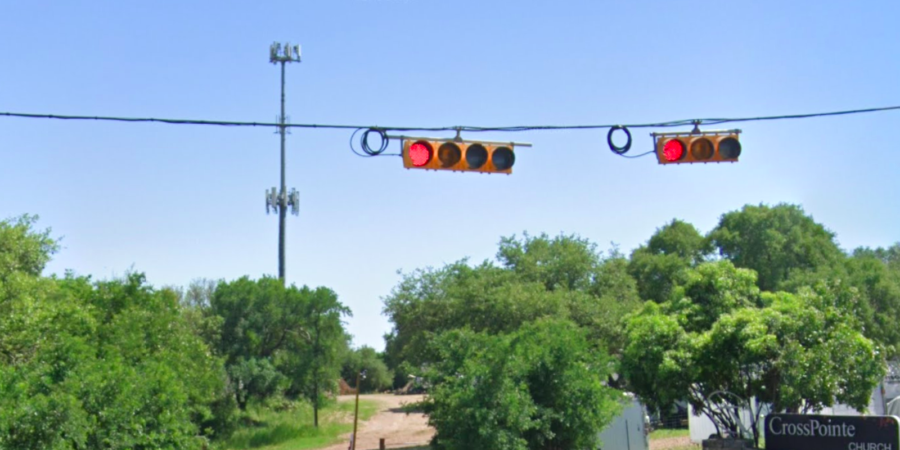
Austin Transportation Department Signs Work Orders
Created By: Susanne Gov Created Date: 2020-08-10 Location Name: 5501 BLK MC NEIL DR (MCNEIL HIGH SCHOOL) Intersection ID: 0 Cardinal Direction: S
Sign Type | Install/Remove

Slide 3
Austin Transportation Department Signs Work Orders
Created By: Susanne Gov Created Date: 2020-08-10 Location Name: 5501 BLK MC NEIL DR (MCNEIL HIGH SCHOOL) Intersection ID: 0 Cardinal Direction: E
Sign Type | Install/Remove
Street Name Sign | Install

Slide 4
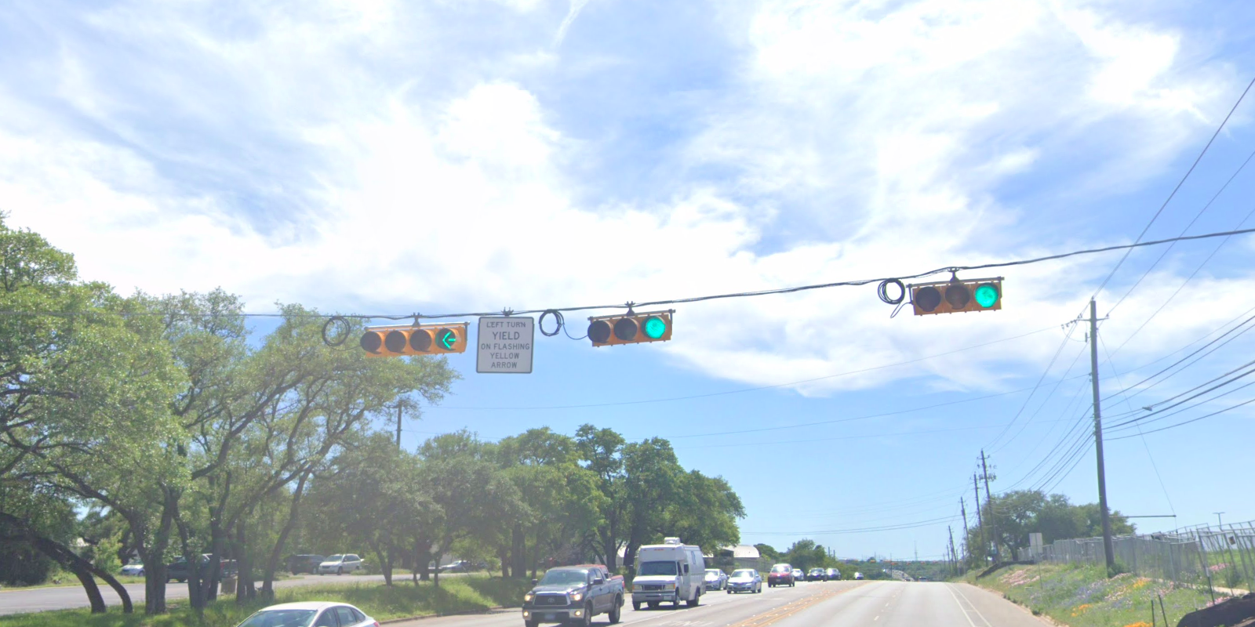
Austin Transportation Department Signs Work Orders
Created By: Susanne Gov Created Date: 2020-08-10 Location Name: 5501 BLK MC NEIL DR (MCNEIL HIGH SCHOOL) Intersection ID: 0 Cardinal Direction: W
Sign Type | Install/Remove
Left Turn Yield Flashing Yellow | Remove

